Slide 1
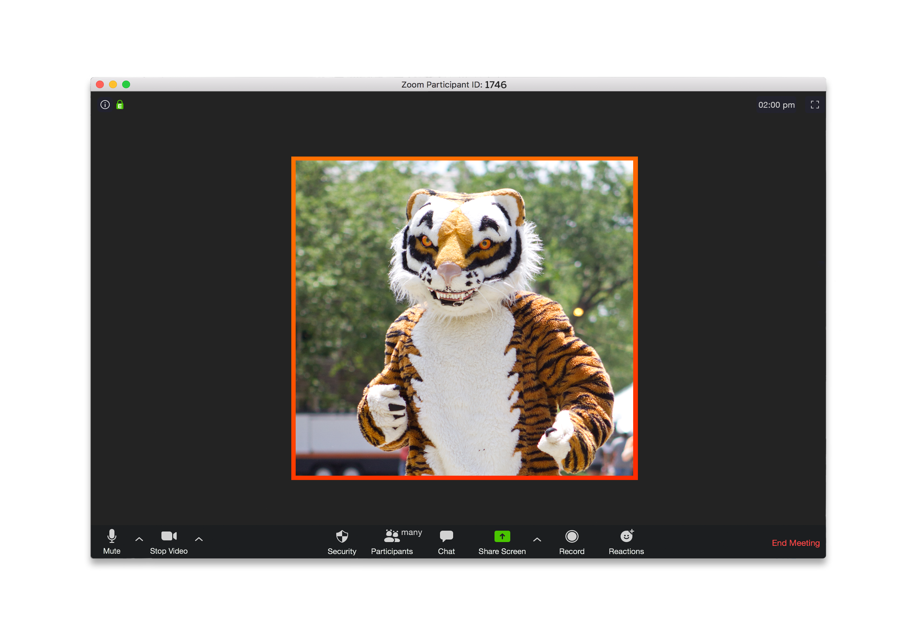
Virtual Event Toolkit
Regional Alumni Associations

Slide 2
Web-based Video Conferencing Platforms
FreeConferenceCall.com - This service is free and hosts up to 1,000 participants with unlimited time video conferencing.
Zoom - The free basic plan hosts up to 100 participants for 40-minute video conferencing.
GoToMeeting - 14-day free trial hosts up to 250 participants; plans start at $12/month.
Cisco WebEx - The free basic plan hosts up to 100 participants; unlimited time video conferencing.
Google Meet – Formerly Google Hangouts, this app hosts up to 100 participants for 60 minutes free of charge, with upgrades starting at $10/month.

Slide 3
Web-based Video Conferencing Platforms: Other Considerations
Check in with your regional board
A fellow Tiger leader may be willing to make a web-based video conferencing platform available through their place of business as part of their employee volunteer program.
Invest for the long term - online events are here to stay!
Build these costs into your operational budget moving ahead.
Take advantage of CORA’s funding opportunity
Apply now for a Committee on Regional Associations (CORA) Virtual Event Grant! Limited grants (up to $150) are available to regional clubs seeking to foster, increase and enhance alumni engagement through digital means.

Slide 4
Online Events: Best Hits!
Consider offering a range of events, from informal social hours to structured content, and see what sticks!
New admit receptions Student send-offs
Book club/Princeton Pre-read
Happy hour/Wine tasting
Movie watch party
Cooking/Baking demonstration
Annual dinner/Board meeting
Panel discussion/Fireside chat
Hobby hour/Wellness
Open mic night/Live performance
Trivia/Game night
Princeton diversity discussion
Alumni Association Speakers Bureau
“Tigers in Service” Community service project
Lunch and learn
Icons from flaticon.com

Slide 5
Downloadable Tools & Templates
New to Zoom or looking to polish your skills?
Check out this Guide to Zoom and Guide to Zoom video, produced by the Alumni Council’s Committee on Communications & Technology
Zoom training, resources, and support
Be inspired!
“Bringing Tigers Together in a Virtual Age”: Webinar Recording & Slides
View the CORA Princetagram for event ideas
Ready-made tools
A “run-of-show” ensures that the program host, technical lead and speakers are on the same page
Incorporate visuals and slides with this template presentation slide deck
Make a great first impression with a “Welcome” holding slide
Encourage “stretch” breaks throughout your event
Promote your region’s upcoming events & activities via a “Closing” slide
Help spread the word of Princeton’s community engagement campaign “A Year of Forward Thinking”
And as is tradition when two or more Princetonians “gather”…
Adjourn your event with the singing of “Old Nassau”: Display the lyrics or download & play this recording

Slide 6
Event Tips, Tricks & Considerations
Event timing
Event preparation
Event duration
Mid-week is optimal; avoid Fridays & weekends
Be mindful of all holidays
Limit your event to 60 minutes
If your event will be longer than 60 minutes, consider dividing into 2+ sessions
Launch your event at least 15 minutes early to allow speakers and host(s) to “meet & greet”
Designate both a program host, and a technical lead, as well as back-ups should any issues arise
As host, keep an alternate device handy in case of connectivity issues
Offer a separate “practice session” when featuring a speaker/panelists to address logistics and program flow
Catch people before they sign off for the day – plan events for late afternoon or early evening

Slide 7
Collaborate, Collaborate, Collaborate!
Grow your Tiger audience by teaming up with regional associations (near & far!), affinity groups, or the APGA
Affinity Groups
Asian American Alumni Association of Princeton (A4P)
Association of Black Princeton Alumni (ABPA)
Association of Latino Princeton Alumni (ALPA)
Fund for Reunion / Princeton Bisexual, Transgender, Gay and Lesbian Alumni (BTGALA)
Princeton Women’s Network (PWN)
Contact Grace Penn ’99 to learn more about collaborating with Princeton’s affinity groups
Regional Associations
Search the regional association leadership directory
Association of Princeton Graduate Alumni (APGA)
Learn more about the APGA or contact apga@princeton.edu to explore ways to engage with graduate alumni

Slide 8
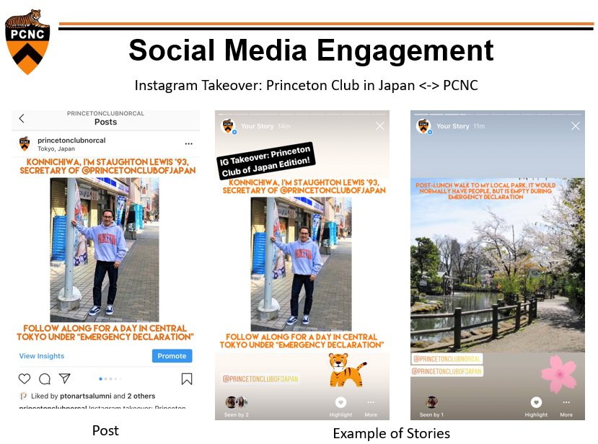
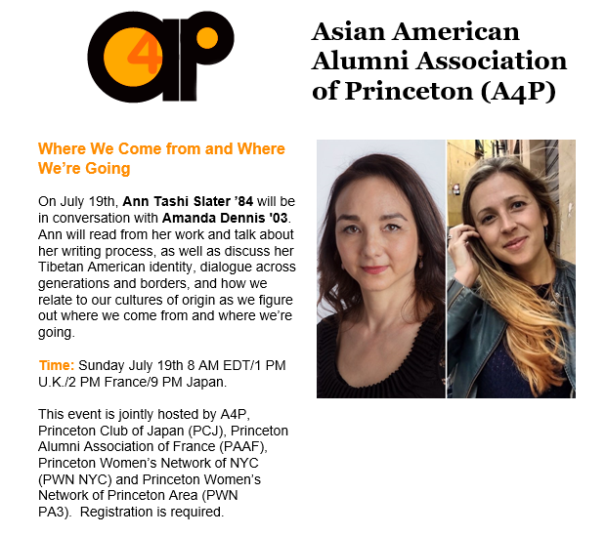
Recent Virtual Collaborations
Transatlantic, multi-region Alumni Pre-read
Multi-region & affinity group sponsored book talk
Regional association social media takeover
Multi-region & affinity group sponsored writing workshop

Slide 9
Communications & Promotions: Best Practices
Save the Date
5-6 weeks out
Invitation #1
3-4 weeks out
Reminder
2 weeks out
Confirmation (include event link)
2 days prior to event
Final Reminder
Early on event day
Suggested Promotional Timeline
Promote your event across all available mediums:
Email (switch up the subject line)
Regional association website
Social media channels
Share throughout your personal Princeton network
Pro tips:
Share the meeting link (and password) 2-3 hours before the event with your entire membership for a boost in attendance
Offer a dial-in number for those on the go or without internet access

Slide 10
Post-event: Best Practices
Remember to thank your event talent
Send personalized e-notes of gratitude to your speakers and event organizers
Gain valuable insights through post-event surveys
Explore free survey tools such as survey monkey and free online surveys
Create a short survey ahead of the event & share a link at the end in the chat box or email event attendees soon after
Crowdsource new event ideas and panel topics
Archive your event
With participant and speaker permission, record your event to share with
those Tigers who registered but could not attend
Icons from flaticon.com

Slide 11
“Prince-tify” Your Online Gatherings
Incorporate that unique Princeton touch into your events to keep your members coming back for more
Tiger spirit & conversation!
Virtual meeting backgrounds
Reunions Online
Princeton University Communications
Encourage orange & black attire
Offer a “Princeton spirit” award for best dressed
Plan a Princeton-themed trivia event
Browse this searchable Princeton Companion Book for ideas and inspiration
Provide a “Tiger Tiger Tiger” themed beverage or snack/recipe

Slide 12
Think Outside the “Zoom” Box
Keep your regional community connected to Princeton through social media
Amplify @PrincetonAlumni content to your regional community
Explore ways to interact and collaborate through social media with other Princeton alumni groups
Consider Facebook and Instagram livestream features for alumni-led talks, interviews and panels to reach even more Tigers
Add a Tiger touch to your region’s social media content with Princeton Reunions GIPHY stickers (available on Facebook, Instagram, Snapchat and more!)

Slide 13
Reminders & Opportunities
Repurpose & share existing University content
Amplify the Alumni Pre-read tradition, faculty books, and other educational offerings found on our academic programming section
Be in touch
Consult with an experienced and savvy regional association leader for support with your region’s online programming. Reach out to a CORA member for one-on-one guidance.
As a regional event host, get free access to Kahoot!, a live trivia web application
Share photos/screen shots of your online events for the annual CORA Princetagram
Have a resource, tip or recommendation to include in this toolkit? Let us know!
Contact the regional affairs team at acra@Princeton.edu

